Slide 1
CYBER SECURITY

Slide 2
What is Cyber Security
Cyber security refers to a set of techniques used to protect computers, networks, programs, devices and data from attacks, damage and unauthorized access.
Effective cyber security reduces the risk of cyber attacks and protects against the unauthorized exploitation of systems, networks and technologies.
It includes two terms: cyber and security
Cyber includes: including everything related to computers
Security means protecting cyber from attacks.

Slide 3
Abstract
Different types of cyber security
Network security is the practice of securing a computer network from intruders, whether targeted attackers or opportunistic malware.
Application security is the process of developing, adding, and testing security features within applications to prevent security vulnerabilities against threats such as unauthorized access and modification.
Information security protects the integrity and privacy of data, both in storage and in transit.
Operational security is a security and risk management process that prevents sensitive information from getting into the wrong hands
Cloud security is concerned with securing data, applications, and infrastructure in the Cloud.

Slide 4
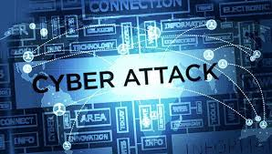
Abstract
What is Cyber Attack
A cyber attack is an attack launched from one or more computers against another computer, multiple computers or networks.
It is an attempt by hackers to damage or destroy a computer network or system.
Those who perform cyber attacks or cyber crime are called cyber criminals.

Slide 5
Abstract
Most Common Cyber Attack
Malware
Phishing
Man-in-the-middle attack
Denial-of-service attack
SQL injection
Zero-day attack

Slide 6
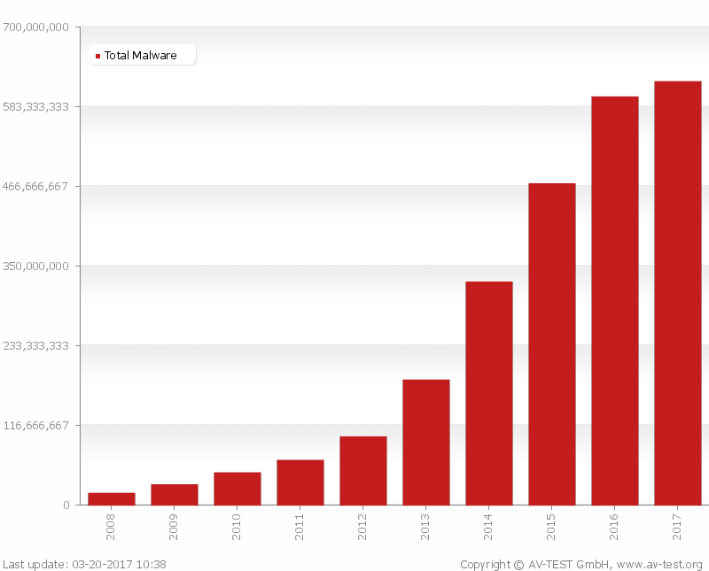
Abstract
Malware
MALWARE is
Malicious Software.
Adware, Spyware,Virus,Worm, Ransomware
Malware can do
allow cybercriminals to get into other people’s computers without their permission
steal personal information
delete files
steal software serial numbers
According to AV-Test in March 2017,the total number of malwares is increasing exponentially since 2008.
Due to such increasing ,it is necessary to detect these files before they harm

Slide 7
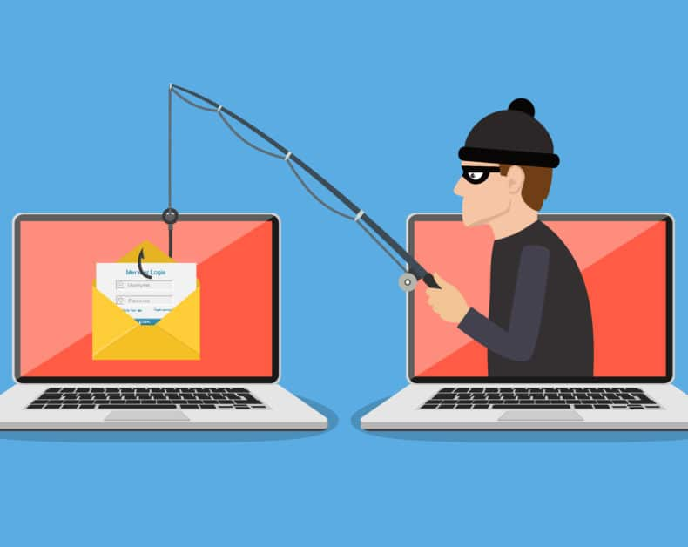
Phishing
In a phishing attack, an attacker may send you an email that appears to be from someone you trust, like your boss or a company you do business with. The email will seem legitimate, and it will have some urgency to it (e.g. fraudulent activity has been detected on your account). In the email, there will be an attachment to open or a link to click. Upon opening the malicious attachment, you’ll thereby install malware in your computer. If you click the link, it may send you to a legitimate-looking website that asks for you to log in to access an important file—except the website is actually a trap used to capture your credentials when you try to log in.

Slide 8
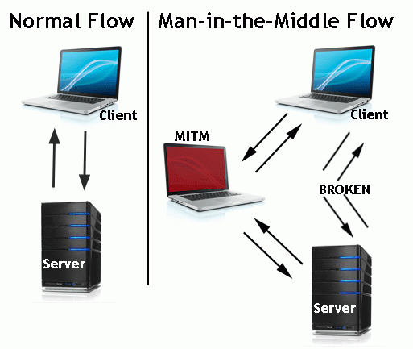
Man-in-the-middle Attack
A man-in-the-middle attack is a type of cyberattack where a malicious actor inserts him/herself into a conversation between two parties, impersonates both parties and gains access to information that the two parties were trying to send to each other. A man-in-the-middle attack allows a malicious actor to intercept, send and receive data meant for someone else, or not meant to be sent at all, without either outside party knowing until it is too late.

Slide 9
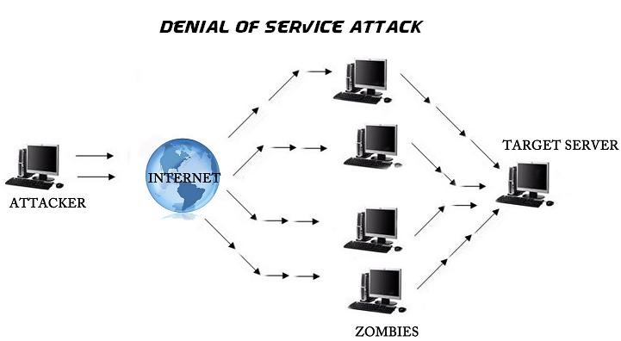
Denial-of-service Attack
A Denial of Service (DoS) attack, consists of sending a large amount of internet traffic towards a server which hosts a website to stop somebody or anybody from accessing it.
As a result, the server is unable to fulfill legitimate requests.
A distributed denial of service (DDoS) attack uses an army of computers, usually compromised by malware and under the control of cybercriminals, to funnel the traffic towards the targets.

Slide 10
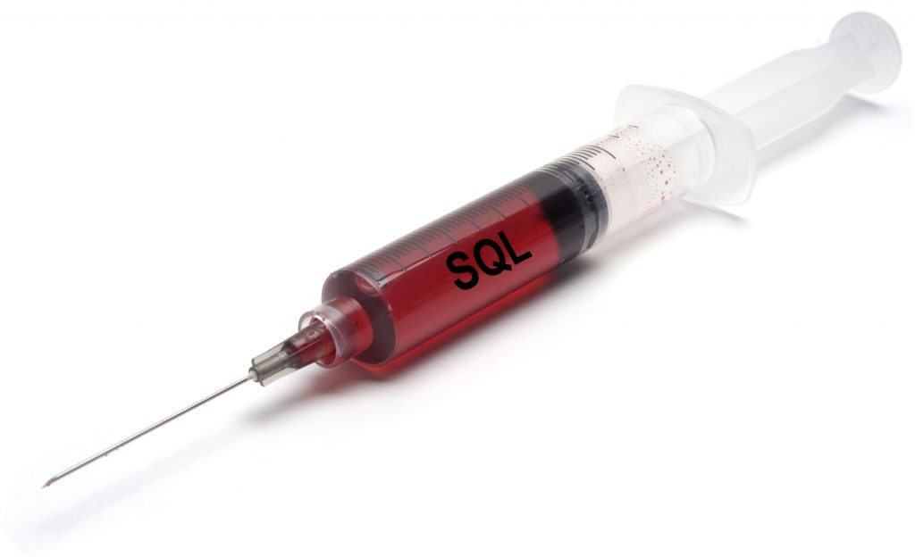
SQL Injection Attack
SQL (pronounced “sequel”) stands for structured query language; it’s a programming language used to communicate with databases.
Many databases are designed to obey commands written in the Structured Query Language (SQL), and many websites that take information from users send that data to SQL databases.
An attacker wishing to execute SQL injection manipulates a standard SQL query and forces the server that stores the database to reveal or manipulate information it normally would not.

Slide 11
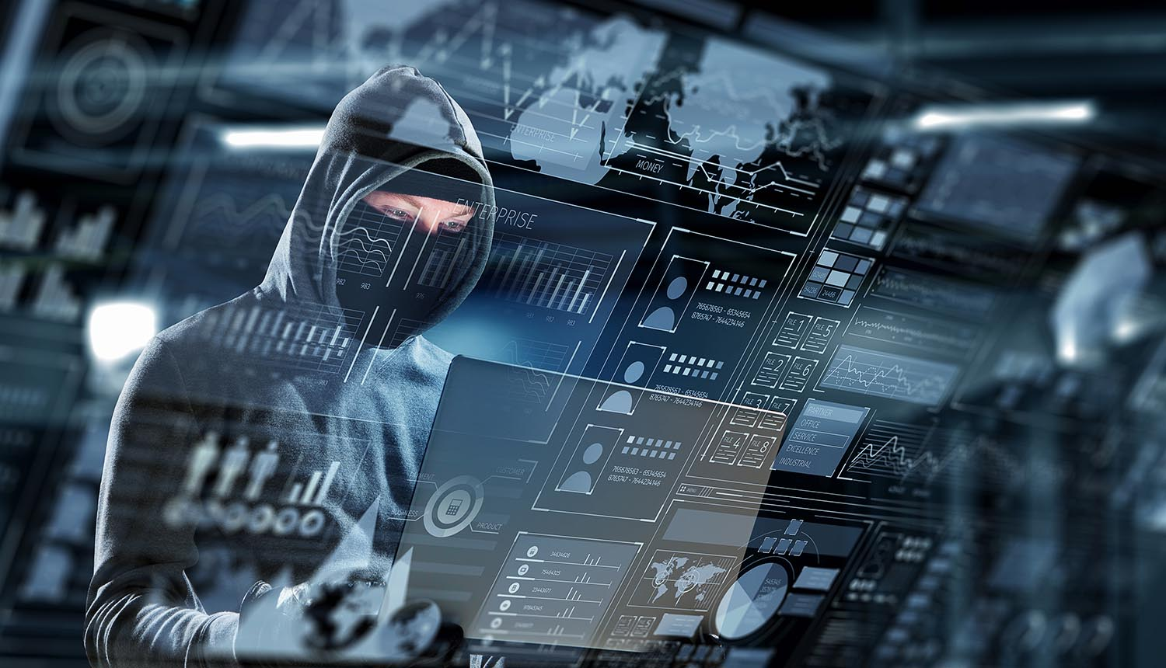
Cyber crime
Cyber crime is an activity done using computers and internet. We can say that it is an unlawful acts wherein the computer either a tool or target or both.

Slide 12
Abstract
Categories of Cyber crime
We can categorize cyber crime in two ways.
The computer as a target :- using a computer to attacks other computer, e.g. Hacking, virus/worms attacks, Dos attack etc.
The computer as a weapon :- using a computer to commit real world crime e.g. cyber terrorism, credit card fraud etc.

Slide 13
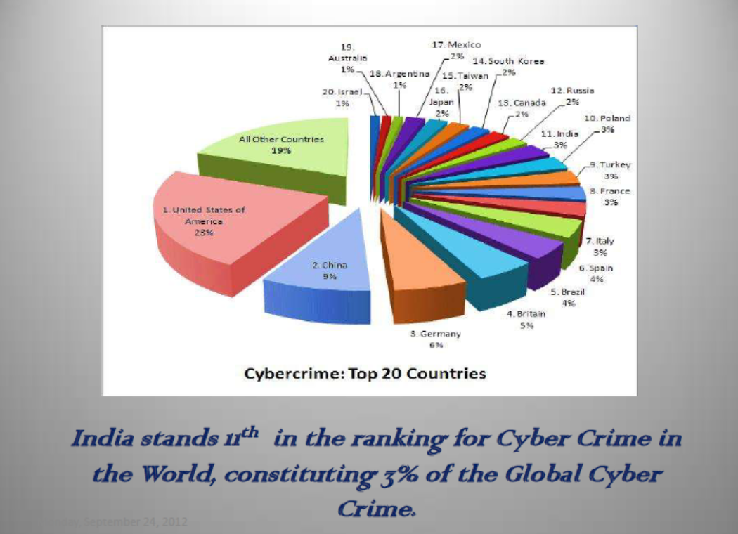
Abstract
Cyber crime statistics in India
In India
121 Million Internet Users
65 Million Active Internet Users,
50 Million users shop online on Ecommerce and Online Shopping Sites
46+ Million Social Network Users
346 million mobile users had subscribed to Data Packages.

Slide 14
Abstract
Cyber crime statistics in India
The majority of cybercrimes are centered on forgery, fraud and Phishing.
India is the third-most targeted country for Phishing attacks after the US and the UK,
Social networks as well as ecommerce sites are major targets,
15,000 sites hacked in 2011,
India is the number 1 country in the world for generating spam
29.9 million people fell victim to cybercrime,
$4 billion in direct financial losses,
$3.6 billion in time spent resolving the crime,
4 in 5 online adults (80%) have been a victim of Cybercrime,
17% of adults online have experienced cybercrime on their mobile phone.
The police have recorded 3,038 cases but made only 2,700 arrests in 3 years (between 2007 and 2010)
India registered only 1,350 cases under the IT Act and IPC in 2010
50% of cybercrimes are not even reported.

Slide 15
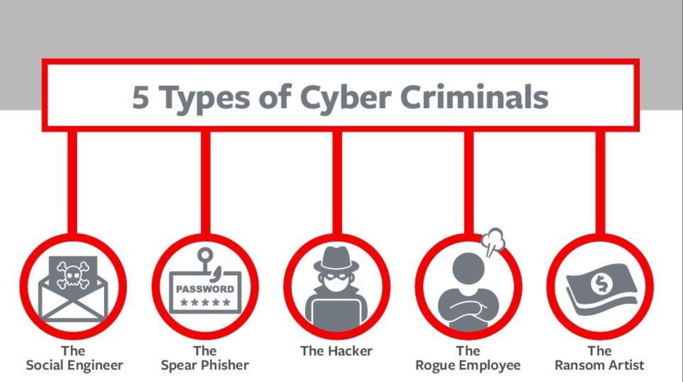

Slide 16
Social Engineer
Social engineering is the art of manipulating people so they give up confidential information. The types of information these criminals are seeking can vary, but when individuals are targeted the criminals are usually trying to trick you into giving them your passwords or bank information, or access your computer to secretly install malicious software–that will give them access to your passwords and bank information as well as giving them control over your computer.

Slide 17
Spear-Phisher
Spear-phishing is a type of phishing attack that targets specific individuals or organizations typically through malicious emails. The goal of spear phishing is to steal sensitive information such as login credentials or infect the targets' device with malware.

Slide 18
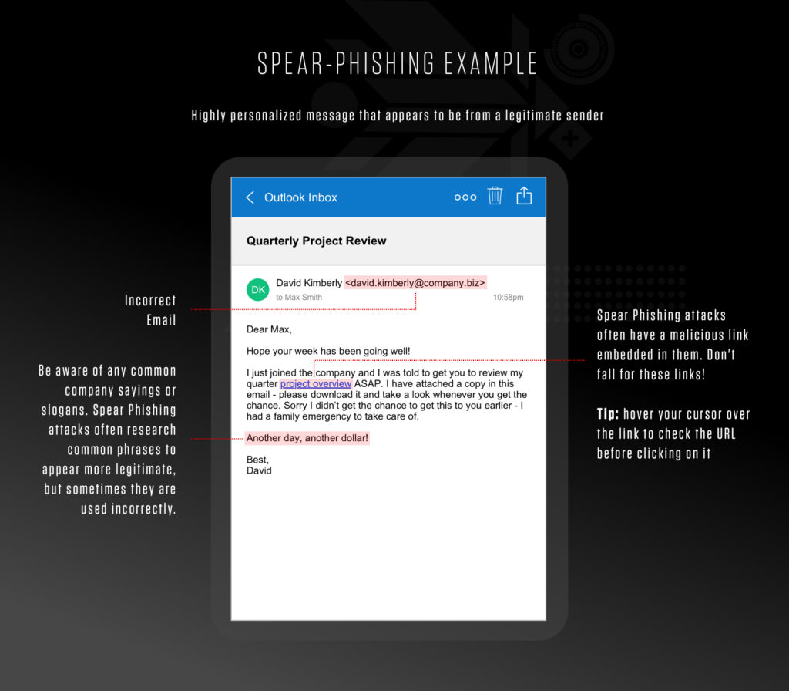

Slide 19
Rouge Employee
A rogue employee is a worker who undermines the organization in which he works by failing to follow its business rules and policies.
Their actions might be relatively harmless or serious enough to pose a risk to the security of your data. In the worst-case scenario, a rogue employee will attempt to undermine your organization by giving your data to a competitor .

Slide 20
Ransom Artist
Ransomware is a malware designed to deny a user or organization access to files on their computer. By encrypting these files and demanding a ransom payment for the decryption key, cyberattackers place organizations in a position where paying the ransom is the easiest and cheapest way to regain access to their file

Slide 21
Hacker
Hacking in simple terms means an illegal intrusion into a computer system and/or network . It is also known as CRACKING. Government websites are the hot target of the hackers due to the press coverage, it receives. Hackers enjoy the media coverage.
Financial theft, media coverage, pen testing
But not all hackers are bad

Slide 22
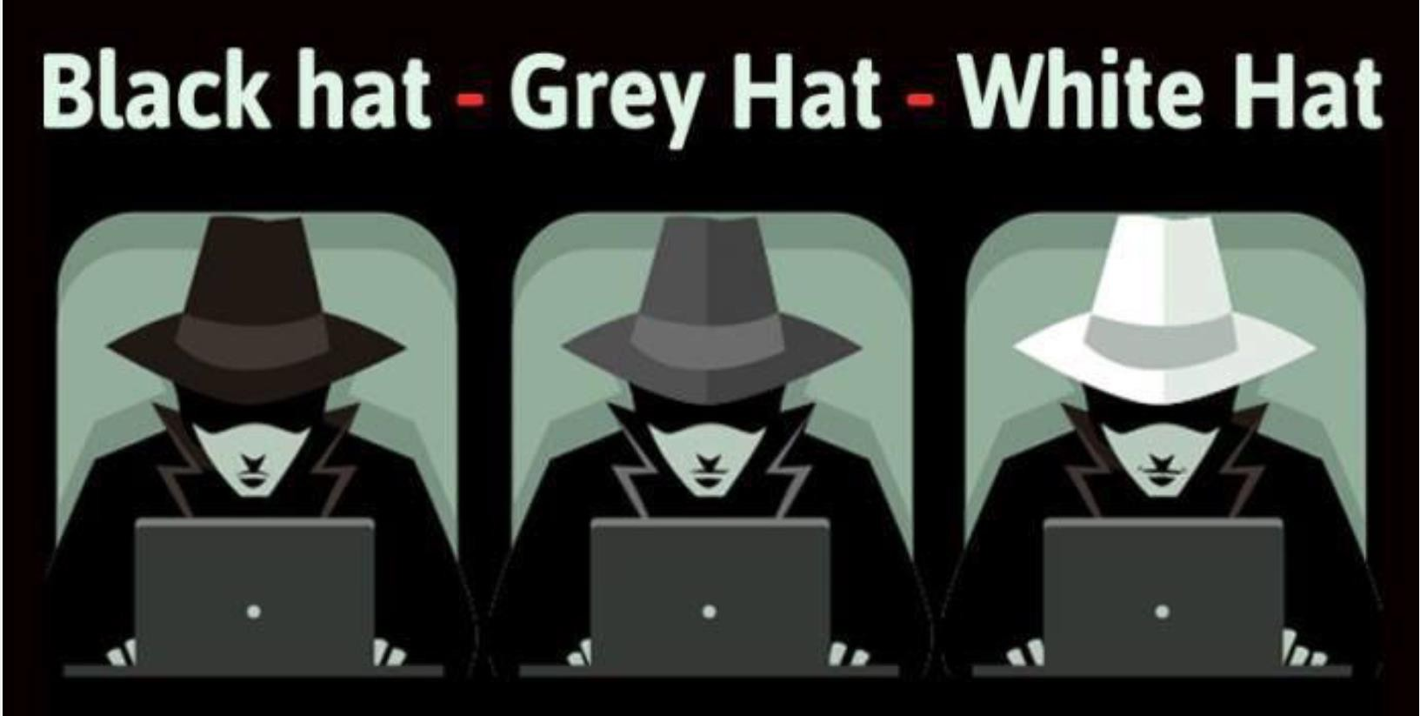
Types of Hacker
There are three types of Hackers
1. Black hat hacker
2. Grey hat hacker
3. White hat hacker
Which hat you want to wear?

Slide 23
Black hat Hacker
Black-Hat Hackers are those hackers who enter the system without taking owners’ permission. These hackers use vulnerabilities s as entry points. They hack systems illegally.
They are the hackers who break into systems, steals passwords, credit card numbers, and other personal information and also releases malware that destroys files.
Black-hat hackers do this financial gain (make money by selling data and credit card information on the dark web) and media coverage, revenge.
Some countries (China, Russia, and the USA) hires black hat hacker to steal data related to militaries from other countries.

Slide 24
White hat hacker
White-Hat Hackers are also known as Ethical Hackers or Good Hackers.
They are certified hackers who learn hacking from courses. These are good hackers who try to secure our data, websites.
These are hackers who are often employed by the government to protect their website, database, software against Black Hat Hacker.
Some ethical hackers work with organizations that find weaknesses in their software. They take permission from the system owners and use hacking techniques identical to black hat hackers, but they do so legally. They make people aware of cyber threats and ways to prevent them.

Slide 25
Grey hat Hacker
Gray-Hat Hackers are a mix of both black and white hat hackers. These types of hackers find vulnerabilities in systems without the owner's permission or knowledge.
If issues are found, they report them to the owner, sometimes requesting a small fee to fix the problem.
They don’t have any malicious intent. However, this type of hacking is still considered illegal. But they never share information with black hat hackers. They find issues and report the owner, sometimes requesting a small amount of money to fix it. These type of hackers does not put someone at risk.

Slide 26
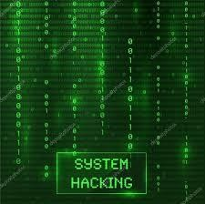
System Hacking
System hacking is a vast subject that consists of hacking the different software-based technological systems such as laptops, desktops, etc.
Here the malicious hacker exploits the weaknesses in a computer system or network to gain unauthorized access to its data or take illegal advantage.
Hackers generally use viruses, malware, Trojans, worms, phishing techniques, email spamming, social engineering, exploit operating system vulnerabilities, or port vulnerabilities to access any victim’s system.

Slide 27
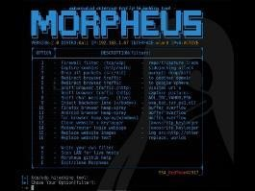
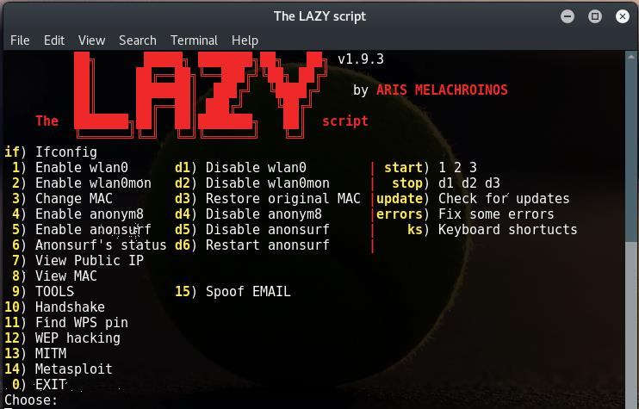
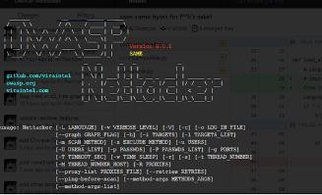
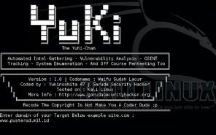
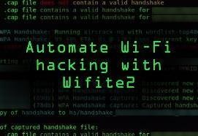
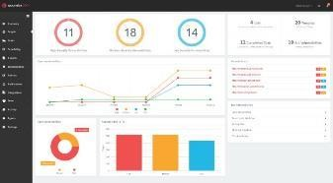
Attacks today are AUTOMATED!
It’s not some dude sitting at his hacker desk all day typing out ping commands to IP addresses via the command prompt manually…

Slide 28
What is Security?
Simple Definition: Achieving some objective(s) in the presence of an adversary
Computers are designed to work co-operatively
Browsers communicate with web (or cloud) servers
Devices communicate with each other (P2P)
You are potentially communicating with unknown entities
People or systems you don’t know and don’t trust
You have no idea how your information is being routed
Any of these people or systems could be an adversary

Slide 29
What is a Secure System? (CIA Triad)
Confidentiality – Preserving authorized restrictions on information access and disclosure
Integrity – protects against improper information modification or destruction
Availability – guarantee timely and reliable access to the information by authorized individuals.
Availability
These three concepts form what is often referred to as the CIA triad. The three concepts embody the fundamental security objectives for both data and for information and computing services

Slide 30
Example of CIA Triad
To have a better understanding of how the CIA Triad works in practice, consider an ATM that allows users to access bank balances and other information. An ATM incorporates measures to cover the principles of the triad:
The two-factor authentication (debit card with the PIN code) provides confidentiality before authorizing access to sensitive data.
The ATM and bank software ensure data integrity by maintaining all transfer and withdrawal records made via the ATM in the user’s bank accounting.
The ATM provides availability as it is for public use and is accessible at all times.

Slide 31
Levels of security breach impact
Low:
If there will be a security breach (i.e., a loss of confidentiality, integrity, or availability), (i) result in minor damage to organizational assets; (ii) result in minor financial loss; or (iii) result in minor harm to individuals.
Moderate:
(i) result in significant damage to organizational assets; (ii) result in significant financial loss; or (iii) result in significant harm to individuals that does not involve loss of life or serious, life-threatening injuries.
High:
(i) result in major damage to organizational assets; (ii) result in major financial loss; or (iii) result in severe or catastrophic harm to individuals involving loss of life or serious life-threatening injuries.

Slide 32
Confidentiality
Assures that private or confidential information is not made available or disclosed to unauthorized individuals
Confidentiality lost if criminal steals customers’ usernames, passwords, or credit card information.
To provide confidentiality, we are using encryption techniques
Enciphering an income tax return will prevent anyone from reading it. If the owner needs to see the return, it must be deciphered by entering a particular key

Slide 33
Confidentiality
Situation 1: Student grades within an Institute
Only accessed by the student and the employees who need that information to work (faculty handling the course, office staff etc.)
HIGH CONFIDENTIALITY
Situation 2: Student Enrollment Information
When the student joined, which courses he/she is taking etc.
Still confidential, but available to more people (all faculty, all office staff etc.)
MODERATE CONFIDENTIALITY
Situation 3: Student / Faculty List at an Institute
Commonly available in public domain
Less likely to be of any issue if disclosed
LOW CONFIDENTIALITY

Slide 34
Integrity
Data integrity: Assures that information and programs are changed only in a specified and authorized manner
System integrity: Assures that a system performs its intended function in an unimpaired manner, free from unauthorized manipulation of the system
origin integrity: the source of the data (often called authentication)
Data Integrity is lost if someone alters payroll information or a proposed product design.
Example: A newspaper may print information obtained from a leak at the White House but attribute it to the wrong source. The information is printed as received (preserving data integrity), but its source is incorrect (corrupting origin integrity).

Slide 35
Integrity
Situation 1: Patient Allergy Information
Doctors must ensure whether the information is correct
Incorrect information could result in severe consequences
HIGH INTEGRITY
Situation 2: Anonymous Online polls
Everyone knows the polls are not trustworthy
LOW INTEGRITY

Slide 36
Availability
Example:
Your customers are unable to access your data or online services (Denial of Service Attacks)
Preventing disruption in how information is accessed
Systems, applications, and data will lose their value if they are not accessible by their authorized users whenever they require them.
Availability is the accessibility of networks, systems, applications, and data by authorized users in a timely fashion whenever resources are required.

Slide 37
Availability
Situation 1: Bank websites, authentication services
Financial transactions might be interrupted, heavy loss of revenue
HIGH AVAILABILITY
Situation 2: University websites
a site is not a critical component of the university’s information system, but its unavailability might cause loss of reputation
MEDIUM AVAILABILITY
Situation 3: Online telephone directory
Offline options available
LOW AVAILABILITY

Slide 38
Computer Security Terminology
Vulnerability
- A weakness in your hardware, software, or procedures. (In other words, it's a way hackers could easily find their way into your system.)
- Can be detected by penetration testing
Threat
- exploits a vulnerability and can potentially harm an information system by disclosing the information stored on the system, adversely modifying data, or making the system unavailable
Risk
- It’s the potential for loss, damage, or destruction of an asset when a threat takes advantage of a vulnerability. Put another way:
Threats + Vulnerability = Risk
A threat represents a potential security harm to an asset.
An attack is a threat that is carried out (threat action) and, if successful, leads to an undesirable violation of security, or threat consequence.

Slide 39
Computer Security Terminology
Adversary (threat agent):
An entity that attacks, or is a threat to, a system.’
Countermeasure:
An action, device, procedure, or technique that reduces a threat, a vulnerability, or an attack by eliminating or preventing it, by minimizing the harm it can cause, or by discovering and reporting it so that corrective action can be taken.
Security Policy:
A set of rules that specify how a system or organization provides security services to protect sensitive and critical system resources.
System Resource (Asset): Data contained in an information system; or a service provided by a system; or a system capability, such as processing power or communication bandwidth.

Slide 40
A model for computer security
Systems resources
Hardware, software (OS, apps), data (users, system, database), communication facilities and network (LAN, bridges, routers, …)
Our concern: vulnerability of these resources (corrupted, unavailable, leaky)
Threats exploit vulnerabilities
Attack is a threat that is accrued out
Active or passive; from inside or from outside
Countermeasures: actions taken to prevent, detect, recover and minimize risks

Slide 41
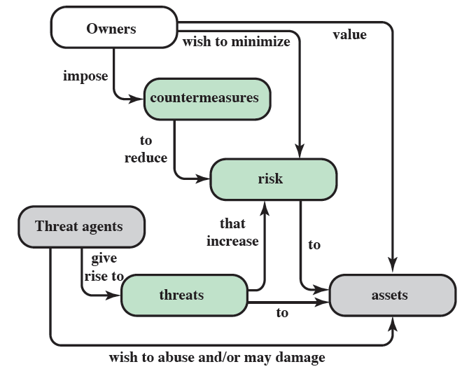
Security concepts and relationships

